Slide 1

Lecture 4 - Analytics
Ben.Lackey@DataStax.com
Partner Architect
+1 720 933 9852
@benofben

Slide 2
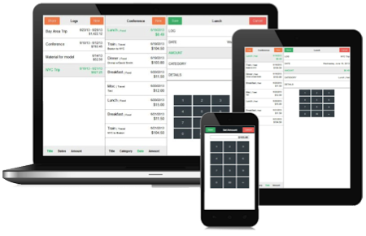
DSE Analytics Reference Architecture
Spark SQL and other goodness
Ops and Developer friendly
Streaming, Hadoop available
No ETL
Cassandra replication
saveToCassandra( )
Replicated, Distributed data
Cache datasets across jobs
Every Analytics node is a worker
True HA without Zookeeper
Master auto-election
Master auto-failover
Single DSE Custer
Your Application
Real Time Operations
Cassandra
Your Analytics
Real Time Replication
Analytics
Queries
Analytics

Slide 3
DSE Analytics Node
Spark and Cassandra
Cassandra
Spark
Data lives in Cassandra
Spark loads data from Cassandra with predicate pushdown
Spark saves data directly to Cassandra tables
Spark Streaming available
memtable A
RDD
memory
storage
sstable A
commit log
Notes:
SSTable = sorted strings table

Slide 4
DSE Streaming Reference Architecture
Single DSE Custer
Streaming
Analytics
Your Application
Message Queue
Batch
Analytics
Real-time

Slide 5
Lab 6 – Analytics
https://github.com/DSPN/DataStaxDay

